Slide 1
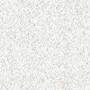
Squint
Loay Abdulmutalib Almusawi
Lecturer at university of Basrah, College of Medicine
FRCS, FIBM, FICO, CRACS

Slide 2
Agenda
Introduction
Amblyopia
Clinical evaluation of strabismus
Pseudostrabismus
Esotropias
Exotropias
Special syndromes
Surgery for strabismus

Slide 3
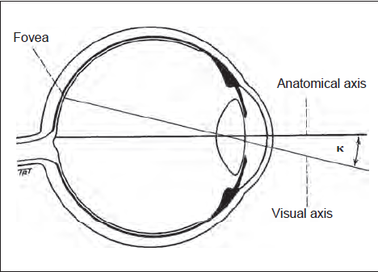
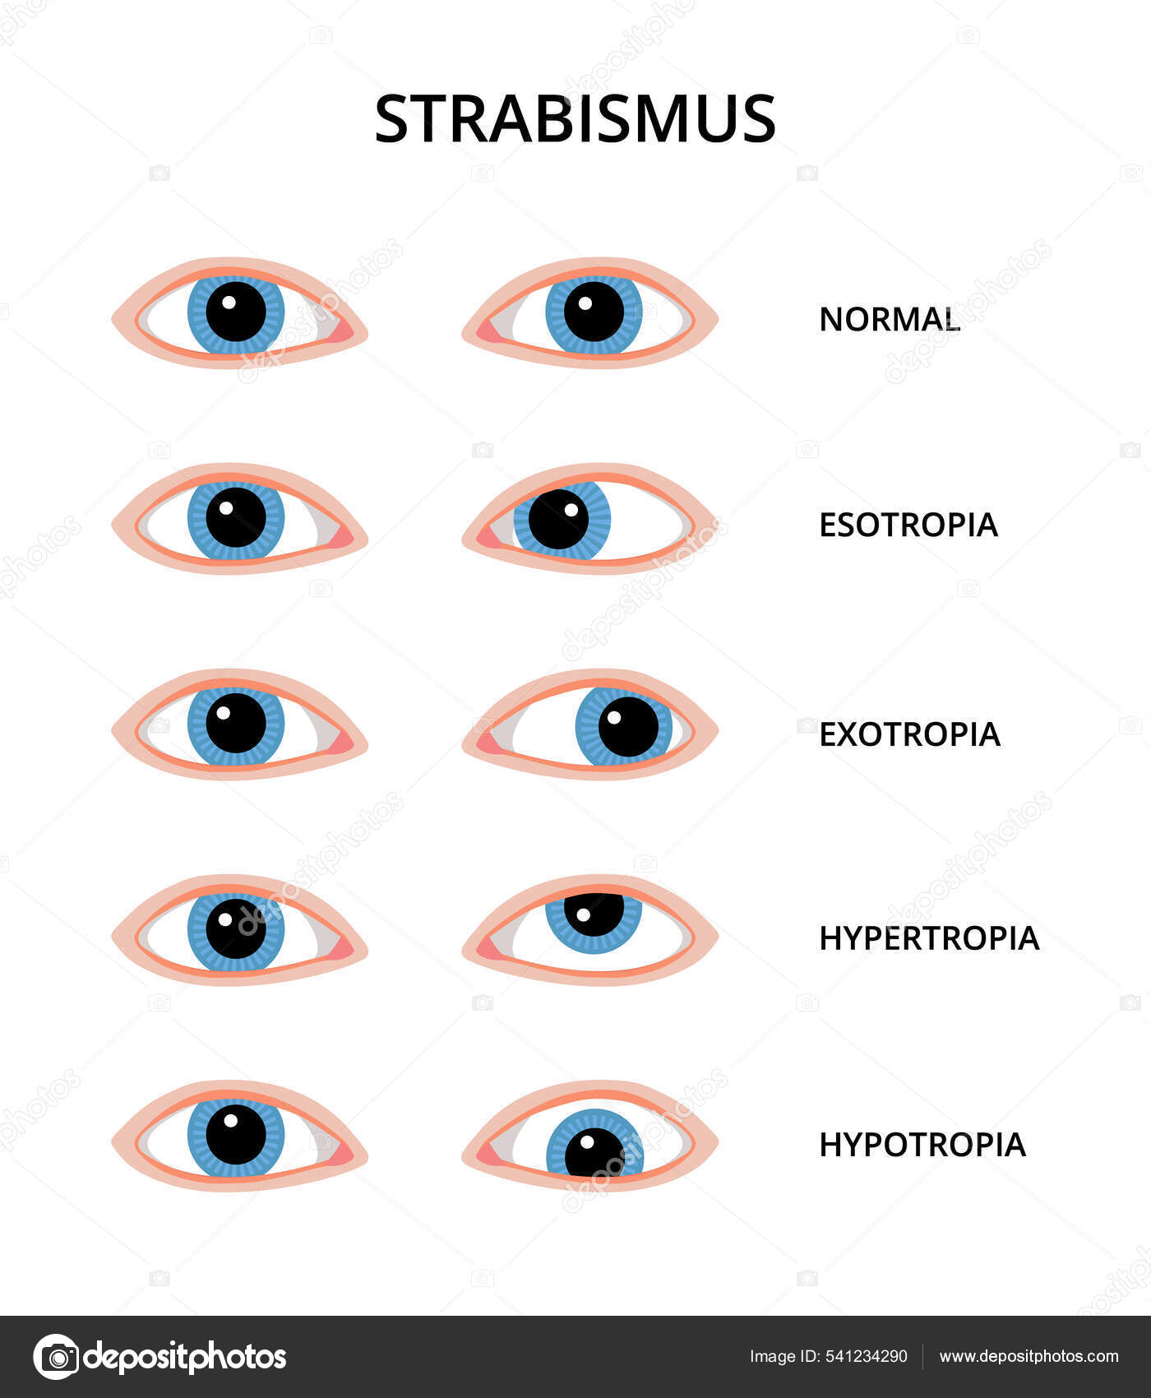
Introduction
Definitions:
  Visual axis: Is a line connecting the fovea to the point of fixation passing through the nodal point of the eye.
  Anatomical axis: is a line passing from the posterior pole to the center of the cornea.
  Angle kappa: angle between these 2 lines.
  Orthophoria: perfect ocular alignment in the absence of sensory stimulus.
  Heterophoria: (‘phoria’) implies a tendency of the eyes to deviate when fusion is blocked (latent squint).
  Heterotropia: (‘tropia’) implies a manifest deviation in which the visual axes do not intersect at the point of fixation. It is of 2 types:
    Concomitant: the angle of deviation remains the same in all directions of gaze.
    Incomitant: the angle changes as a result of muscle paralysis or restriction.

Slide 4
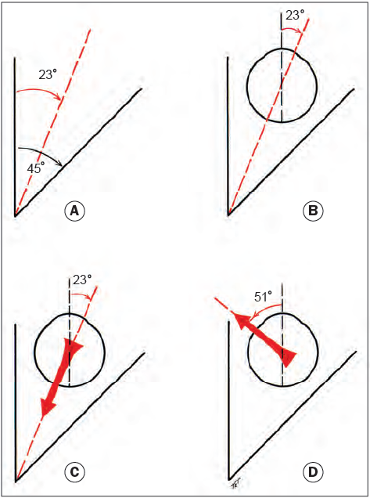
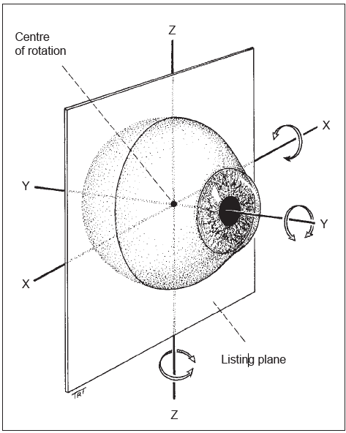
Introduction
Anatomy of extraocular muscles (EOMs):
  The primary action of a muscle is its major effect when the eye is in the primary position.
  Subsidiary actions are the additional effects, which depend on the position of the eye.
  The globe can rotate:
    left and right on the vertical Z axis.
    Up and down on the horizontal X axis.
    Torsional movements (wheel rotations) occur on the Y (sagittal) axis which traverses the globe from front to back (similar to the anatomical axis of the eye).
Notes:
The actions of the extraocular muscles depend on the position of the globe at the time of muscle contraction

Slide 5
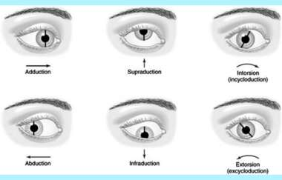
Ductions are movement concerning one eye (the right eye here)

Slide 6
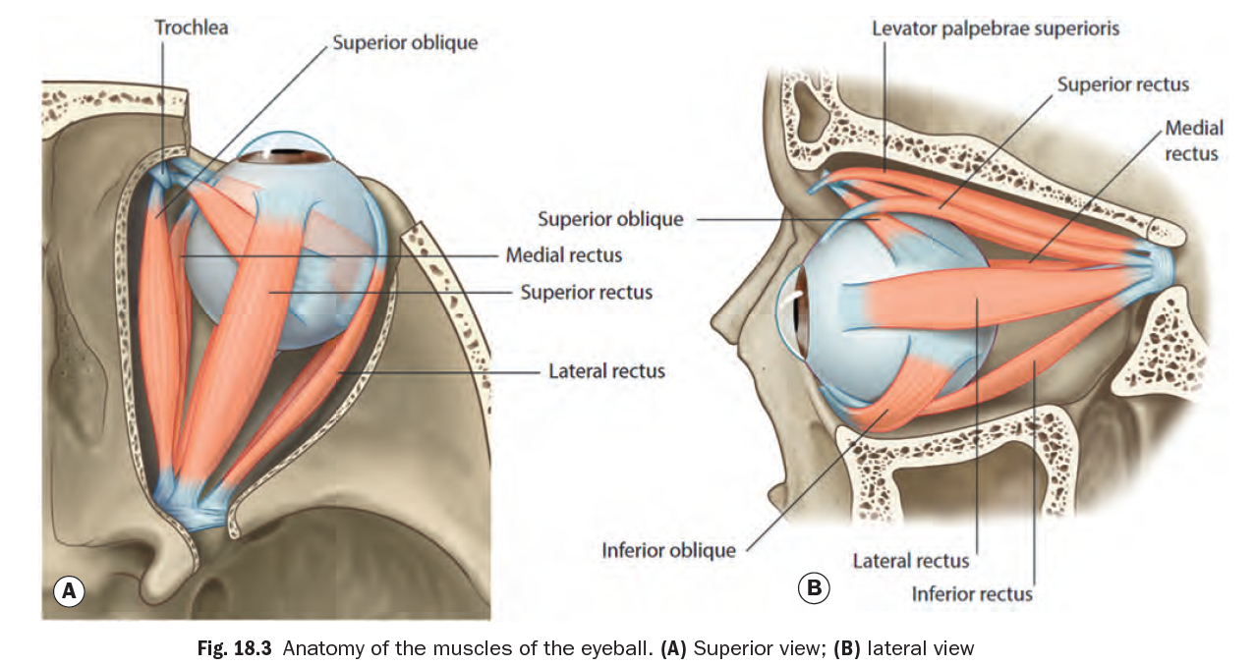

Slide 7
Introduction
Anatomy of extraocular muscles (EOMs):
Muscle | Origin | Insertion | Primary action | Subsidiary action
Medial rectus | Annulus of zin | Behind medial limbus | adduction
Lateral rectus | Annulus of zin | Behind lateral limbus | Abduction
Superior rectus | Annulus of zin | Behind superior limbus | Elevation | Adduction & intortion
Inferior rectus | Annulus of zin | Behind inferior limbus | Depression | Adduction & extortion
Superior oblique | superomedial to the optic foramen | posterior upper temporal quadrant of the globe | Intortion | Depression & abduction
Inferior oblique | a small depression just behind the orbital rim lateral to the lacrimal sac | posterior lower temporal quadrant of the globe close to the macula. | Extorsion | Elevation & abduction
All are innervated by 3rd cranial nerve except superior oblique (4th) and lateral rectus (6th).

Slide 8
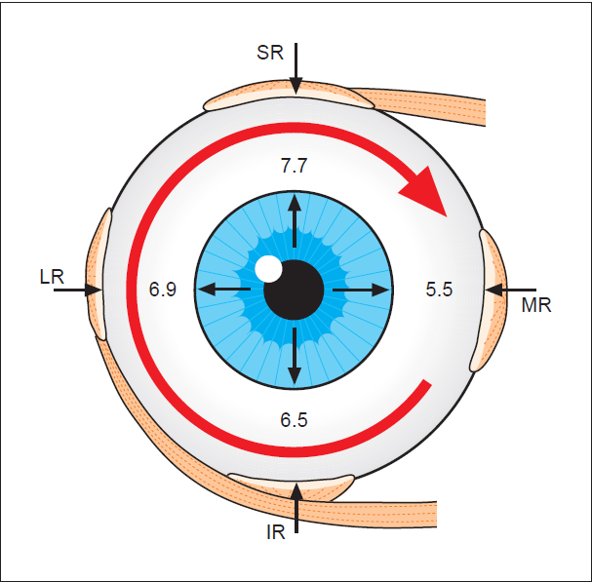

Slide 9
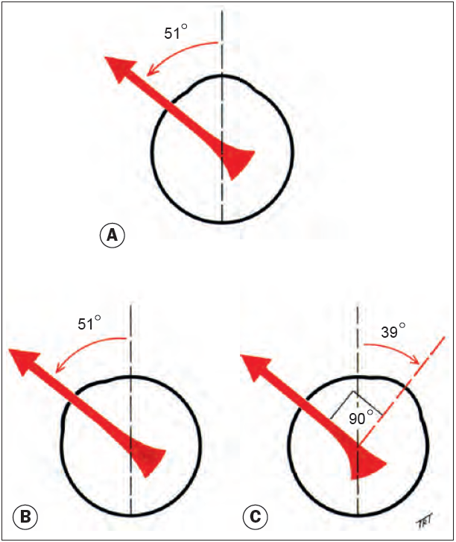
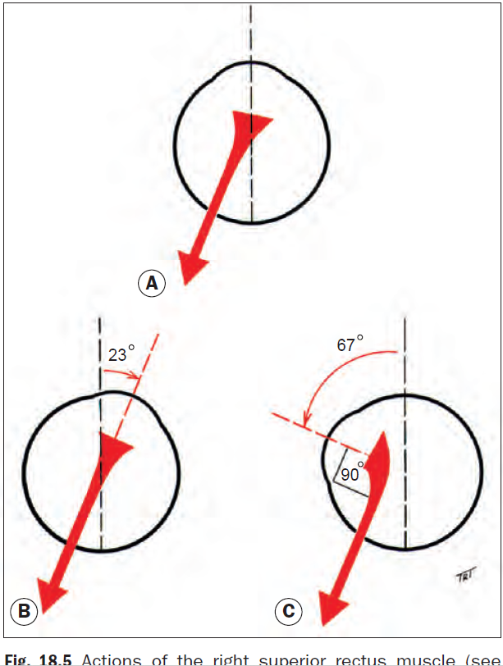

Slide 10
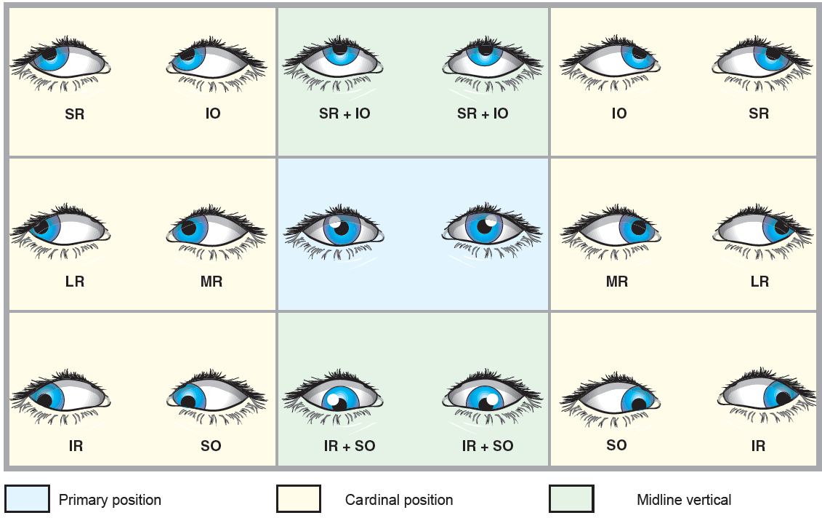
9 diagnostic Positions of gaze

Slide 11
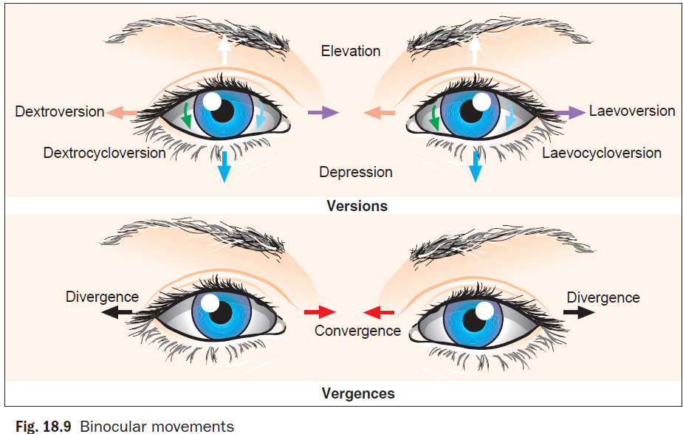

Slide 12
Ocular movements
Binocular
Version
Vergence
Monocular
Duction
Convergence
Divergence

Slide 13
Synkinetic near reflex (near Triad)
On looking at near object, 3 effects will happen:
Accommodation to bring the object in focus on the retina.
Miosis of the pupil
Convergence (Accommodative convergence): it is given in a ratio termed ACA ratio, normally for each diopter of accommodation there is 3-5 ∆ of convergence.
* Abnormalities of ACA ratio plays a critical role in the pathogenesis of certain types of squints.

Slide 14
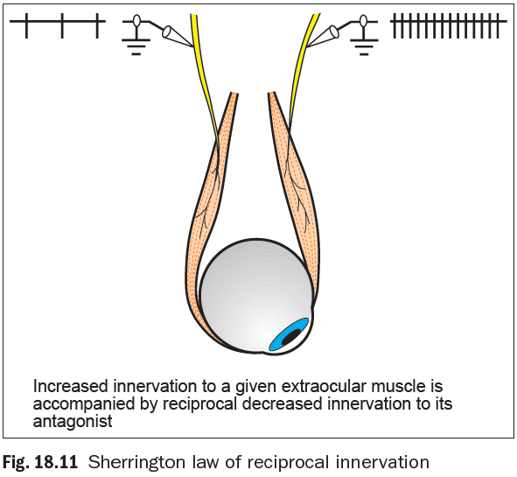
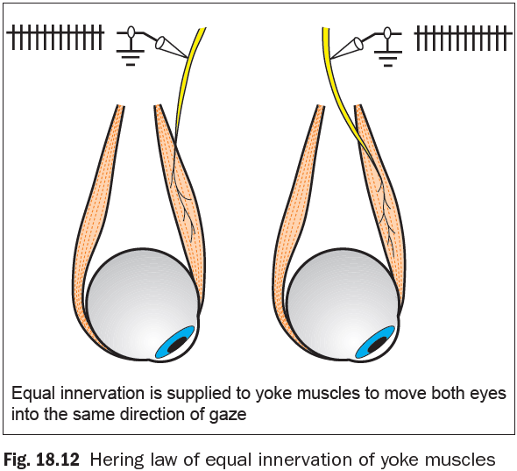
Introduction
Laws of ocular motility
  Agonist–antagonist pairs are muscles of the same eye that move the eye in opposite directions.
  Synergists are muscles of the same eye that move the eye in the same direction.
  Yoke muscles (contralateral synergists) are pairs of muscles, one in each eye, that produce conjugate ocular movements.
  Sherrington law of reciprocal innervation of reciprocal innervation states that increased innervation to an extraocular muscle is accompanied by a reciprocal decrease to its antagonist.
  The Hering law of equal innervation states that during any conjugate eye movement, equal and simultaneous innervation flows to the yoke muscles.

Slide 15
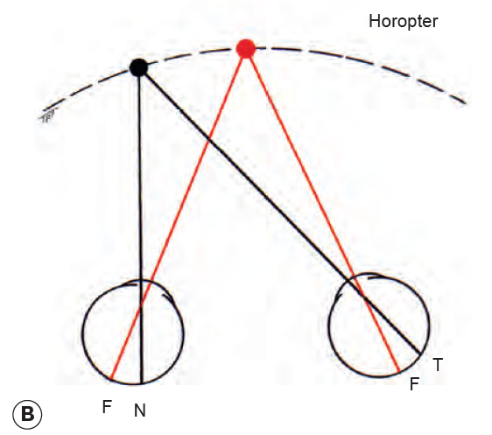
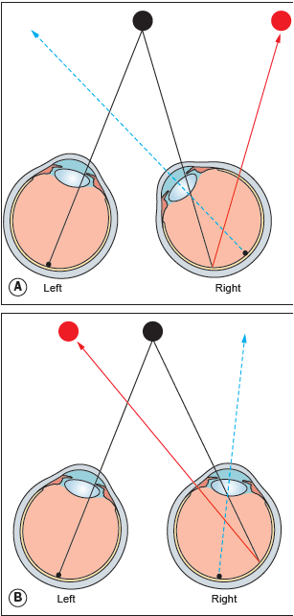
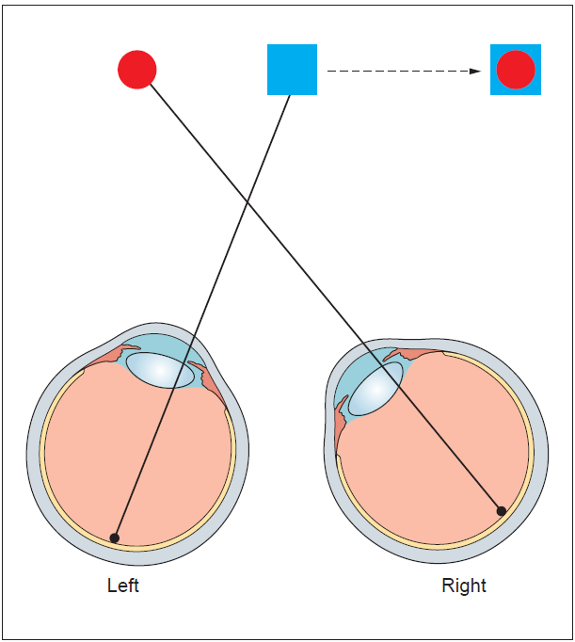
Introduction
Sensory considerations
  Normal BSV involves the simultaneous use of both eyes with bifoveal fixation, so that each eye contributes to a common single perception of the object of regard.
  Stereopsis: is the relative ordering of visual object depth, solid obj are seen stereoscopically in 3 dimensions because each eyes see a slightly different angle aspect of the same obj.
  Confusion: is the simultaneous appreciation of 2 superimposed but dissimilar images caused by stimulation of the 2 foveae by different objects.
  Pathological Diplopia: is the simultaneous appreciation of two images of the same object in different positions and results from images of the same object falling on noncorresponding retinal points. In esotropia the diplopia is homonymous (uncrossed), in exotropia the diplopia is heteronymous (crossed).

Slide 16
Introduction
Adaptation to strabismus
  Sensory adaptation:
    Suppression (negative adaptation): involves active inhibition by the visual cortex of the image from one eye when both eyes are open. It can be central or peripheral, monocular or alternating, facultative or obligatory. It is a precursor of amblyopia
    Anomalous retinal correspondence (ARC): a condition in which non-corresponding retinal elements acquire a common subjective visual direction, so that the fovea of the fixing eye is paired with a non-foveal retinal element. It is usually seen in small angle manifest squint.
  Motor adaptation:
    Face turn
    Head tilt
    Chin elevation or depression

Slide 17
Amblyopia
Is the unilateral, or rarely bilateral, decrease in best corrected visual acuity (VA) caused by form vision deprivation and/or abnormal binocular interaction, for which there is no identifiable pathology of the eye or visual pathway.
Strabismic amblyopia results from abnormal binocular interaction where there is continued monocular suppression of the deviating eye.
Anisometropic amblyopia is caused by a difference in refractive error between the eyes and may result from a difference of as little as 1 diopter. The more ametropic eye receives a blurred image and thereby becomes amblyopic.
Stimulus deprivation amblyopia results from vision deprivation. It may be unilateral or bilateral and is typically caused by opacities in the media (e.g., cataract) or ptosis that covers the pupil.
Bilateral ametropic amblyopia results from high symmetrical refractive errors, usually hypermetropia.

Slide 18
Amblyopia
The visual system in children is characterized by its plasticity. When the cause of amblyopia is reversed, vision may be restored to normal with appropriate therapy, however, when treatment is delayed beyond the sensitive period, the condition will become permanent.
An organic disease must be excluded before commencing therapy. Sometimes they may co-exist.
Occlusion therapy: the normal eye is occluded to encourage the use of the amblyopic eye. It is the most effective therapy. However, Poor compliance is the single greatest barrier to improvement and must be monitored. It is of 2 types
  Full time
  Part time
Penalization with atropine drops, It may work best in the treatment of mild–moderate amblyopia (6/24 or better), especially when due to anisometropic hypermetropia. Patch occlusion is likely to produce a quicker response than atropine, which has conventionally been reserved for use when compliance with patch occlusion is poor.
Notes:
If there is no improvement after 6 months of occlusion, then further treatment is unlikely to be fruitful.

Slide 19
Clinical evaluation of strabismus
History
Visual acuity
Tests for stereopsis & sensory anomalies
Measurement of deviation
Mapping Ocular motility
Refraction and fundoscopy

Slide 20
History Taking
Age of onset: type of squint, risk of amblyopia, previous photos.
Associated symptoms: asthenopia, diplopia, cosmetic blemish.
Variability
General health e.g., CP, developmental issues, trauma…
Birth history (e.g., prematurity and low BW).
Family history (type of squint & its management)
Previous ocular history
  Glass prescription, occlusion therapy, previous surgery..

Slide 21
Visual Acuity Testing
In preverbal children
Qualitative → fixation behavior, aversion to occlusion
Quantitative → preferential looking test, pattern VEP
In verbal children
At 2 years of age → picture naming test (crowded Kay pictures)
At 3 years of age→ letter matching
At 4 years of age → tested as adults.

Slide 22
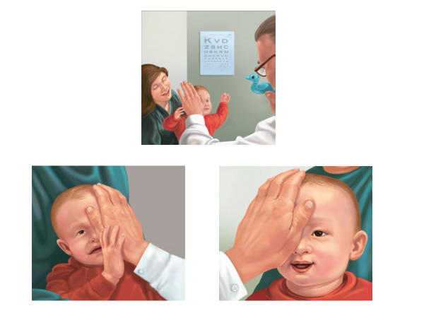

Slide 23
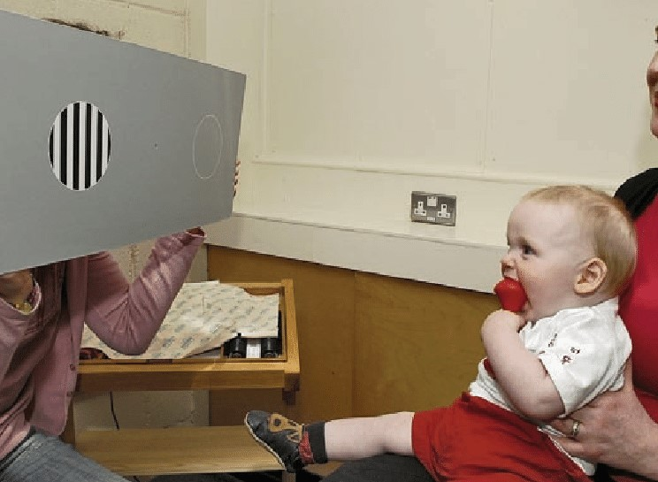
Preferential looking test for infants

Slide 24
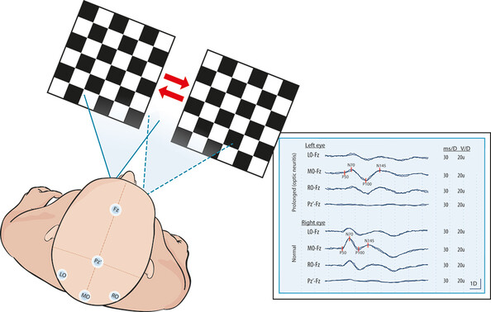

Slide 25
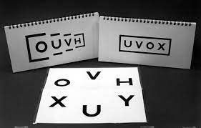

Slide 26
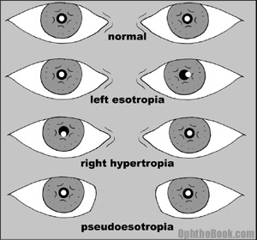
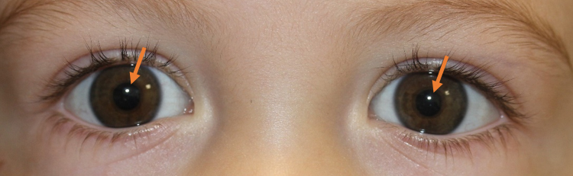
Hirschberg test
It gives a rough objective estimate of the angle of a manifest strabismus and is especially useful in young or uncooperative patients or when fixation in the deviating eye is poor.
A pen torch is shown to the eyes from arm’s length the patient is asked to fixate the light. The corneal reflection of the light will be (more or less) centered in the pupil of the fixating eye, but will be decentered in a squinting eye, in the direction opposite to that of the deviation.
Each millimetre of deviation is approximately equal to 7° (1° ≈ 2 prism dioptres).
E.g., if the reflex is at the border of the pupil → 15° deviation, if at the limbus → 45°

Slide 27
Krimsky and prism reflection tests
The Krimsky test involves placement of prisms in front of the fixating eye until the corneal light reflections are symmetrical. This test reduces the problem of parallax and is more commonly used than the prism reflection test.
The prism reflection test involves the placement of prisms in front of the deviating eye until the corneal light reflections are symmetrical.
Notes:
These test give more accurate measurement of the deviation than the crude Hirschberg

Slide 29
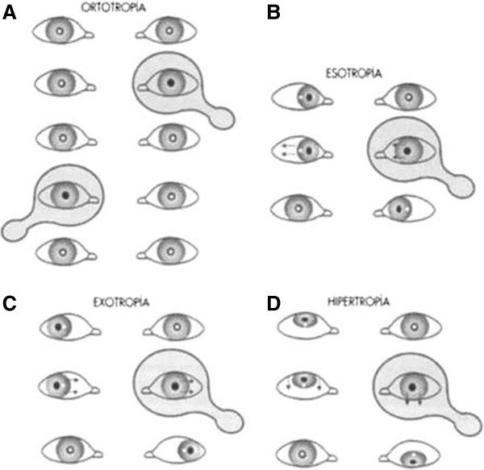
Cover–uncover test
Cover test is used to detect heterotropias (manifest deviation)
Begin the test by using an accommodative target for near, then test for distance.
Cover one eye and observe the movement of the other eye.
You can repeat it for the other eye.

Slide 30
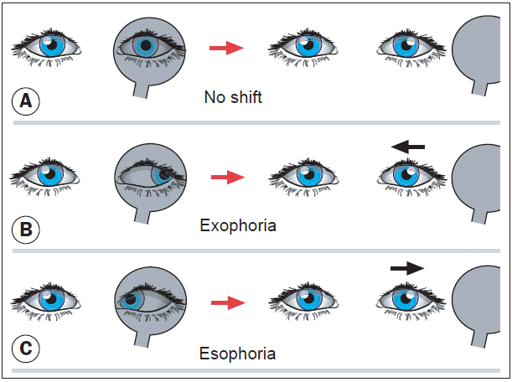
Cover–uncover test
Uncover test is used to detect heterophorias (latent dev)
Begin the test by using an accommodative target for near, then test for distance.
Cover one eye for 2-3 seconds then remove the cover & observe if there is any movement.
You can repeat it for the other eye.
Few individuals are truly orthophoric particularly with near fixation.

Slide 31
Alternate Cover Test
It induces dissociation between the 2 eyes so that it reveals the total deviation (manifest + Latent).
The right eye is covered for several seconds.
The occluder is quickly shifted to the opposite eye for 2 seconds, then back and forth several times. After the cover is removed, the examiner notes the speed and smoothness of recovery as the eyes return to their pre-dissociated state.
This test can break heterophoria into heterotropia.

Slide 32
Prism cover test
The previous test can be repeated with prisms of progressively increasing power placed in front of one eye util no movement is seen.
The prisms are placed with their apex pointing in the direction of deviation.

Slide 33
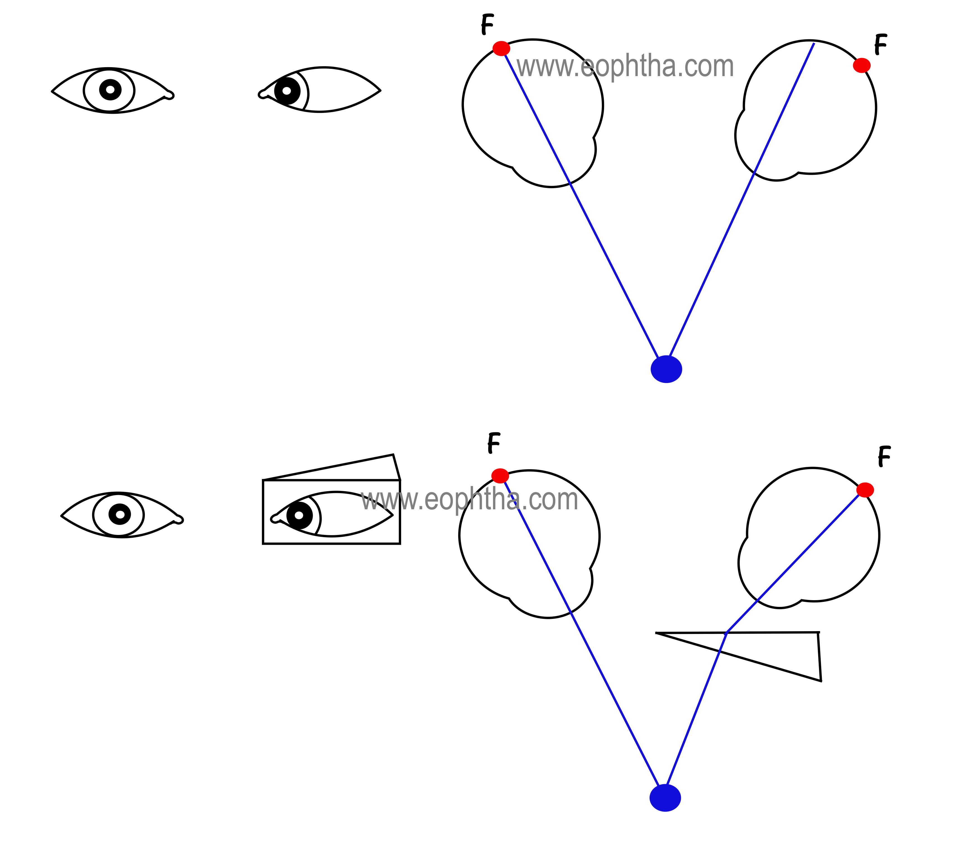

Slide 34
Dilated fundoscopy is mandatory in the context of strabismus, principally to exclude any underlying ocular pathology such as macular scarring, optic disc hypoplasia or retinoblastoma as the cause of the deviation.
More commonly, strabismus is secondary to refractive error; hypermetropia (most common), astigmatism, anisometropia and myopia may all be associated.
It is essential that retinoscopy with instillation of cycloplegic agents (e.g., atropine or cyclopentolate) is performed in all children with strabismus, keeping in mind that most normal children have mild hyperopia (1-3 D).
TIP In the presence of esotropia, the full cycloplegic hypermetropic correction should be prescribed, even in children under the age of 2 years.
Refraction and Fundoscopy

Slide 35
Which type of squint do these patients have?

Slide 36
Pseudostrabismus
Is the clinical impression of ocular deviation when no squint is present.
Epicanthic folds may simulate an esotropia
Abnormal interpupillary distance, if short may simulate an esotropia and if wide an exotropia.
Abnormal angle kappa
  Large positive angle kappa (fovea temporal to the center) → pseudoexotropia
  Negative → pseudoesotropia

Slide 37
Esotropia
Manifest convergent squint

Slide 38
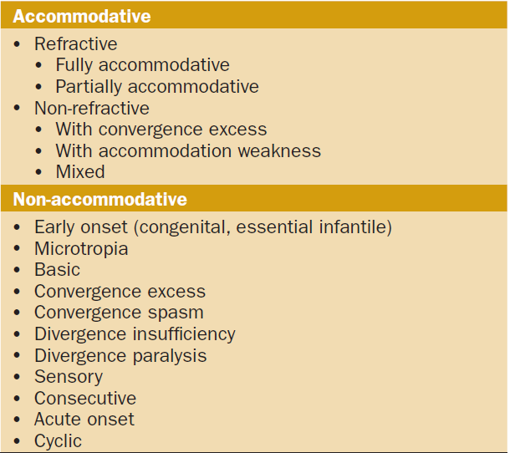
Classification of Concomitant Esotropias

Slide 39
Infantile esotropia
Is an idiopathic esotropia developing within the first 6 months.
In an otherwise normal infant.
No significant refractive error.
The angle is usually fairly large (>30 Δ) and stable.
Fixation in most infants is alternating in the primary position.
There is cross-fixation in side gaze, which may give false impression of bilateral 6th nerve palsy.
Nystagmus may be present.
Vertical misalignment on side gaze due to inferior oblique overaction may be present. It may also occur when one eye is covered.
DDx → bilateral 6th nerve palsy, sensory esotropia, Duane syndrome…

Slide 40
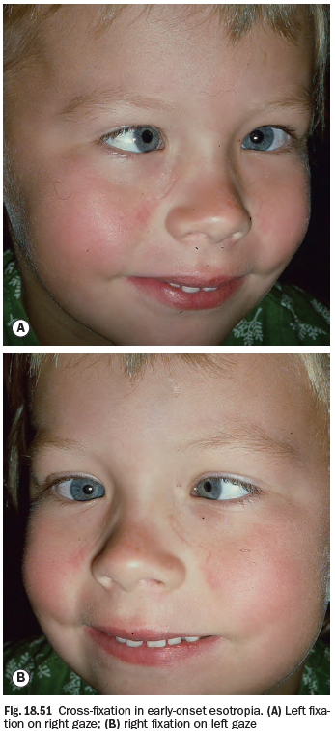
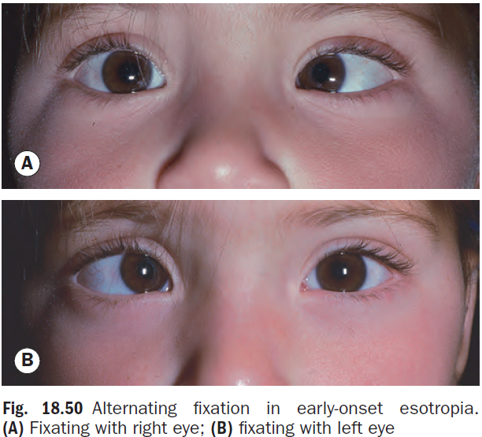

Slide 41
Treatment of infantile esotropia
Ideally, the eyes should be surgically aligned by the age of 12 months and at the very latest by the age of 2 years, but only after amblyopia and any significant refractive error have been corrected.
The surgery involves medial rectus recession and/or lateral rectus resection in one or both eyes according to the angle of dev and presence or absence of amblyopia.
After surgery, amblyopia should be monitored for (it develops in up to 50%) and regular refraction should be done.
Additional surgeries may be required for vertical misalignment which might develop later on.

Slide 42
Accommodative esotropias
In the refractive type, there is normal ACA ratio but there is a hypermetropic refractive error (+2 to +7 D). The age of onset is usually around 2 years but can range between 6 mo to 7 yrs. Since the ACA ratio is normal, the angle of deviation remains the same or changes very little between far and near.
In the fully accommodative type, the deviation is eliminated and BSV is restored when the full cycloplegic refractive error is corrected with glasses. While in the partial type, the angle of dev is reduced but cannot be totally eliminated with glasses, surgery for this type should be done according to the residual angle of deviation and it involves either bimedial recession when no amblyopia is present or unilateral medial rectus recession and lateral rectus resection if that eye is amblyopic.

Slide 43
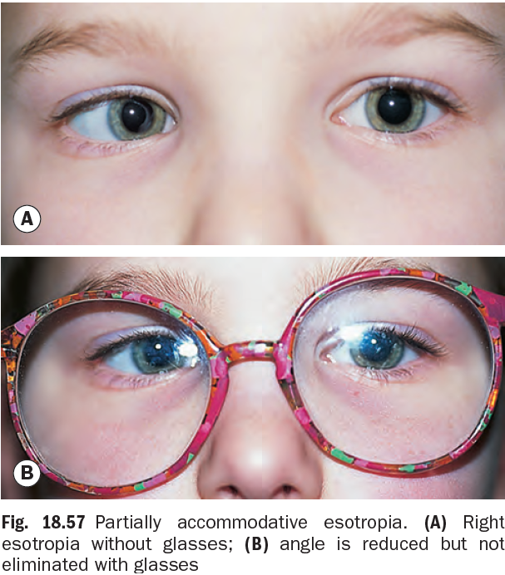
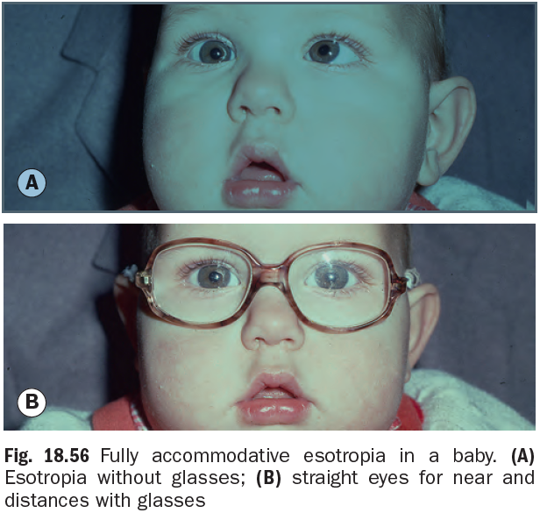

Slide 44
Accommodative esotropias
In the non-refractive type sometimes called convergence excess esotropia, there is no significant refractive error, however, there is an abnormally high ACA ratio, therefore, the angle of dev is greater for near than far.
Treatment of such condition requires a special type of glasses called bifocals, which have different powers for near and far (near add) to decrease the need for accommodation for near targets and eliminate the deviation for near allow some degree of BSV. Meiotic therapy with pilocarpine can be an alternative.
Surgery is considered for partially accommodative type as described.
Amblyopia if present must be treated prior to surgery

Slide 46
Other types of esotropia
Secondary (sensory): it is caused by unilateral reduction in vision that interferes with or abolishes fusion. Such as cataract, optic atrophy or hypoplasia, macular scarring or retinoblastoma.
Consecutive esotropia: it follows surgical overcorrection of an exodeviation.
Acute (Late-onset esotropia): around 5-6 yrs with no significant refractiver error & normal ocular motility.
Near esotropia
Distance esotropia
Cyclic esotropia
Paralytic esotropia: as in sixth nerve palsy.

Slide 48
Exotropia

Slide 49
Intermittent Exotropia
Presentation is often at around 2 years with exophoria, which breaks down to exotropia under conditions of visual inattention, bright light (resulting in reflex closure of the affected eye), fatigue or ill health.
The eyes are straight with BSV at times and manifest with suppression at other times. The control of squint may vary with distance.
Treatment:
Spectacle correction in myopic patients may, in some cases, control the deviation by stimulating accommodation and with it, convergence.
Orthoptic exercises
Part time occlusion of the non-deviating eye.
Surgery indicated if control is poor or is progressively deteriorating.

Slide 51
Constant (early-onset) Exotropia
Presentation is often at birth.
Normal refraction for age.
Large constant angle of deviation.
Neurological anomalies are frequently present.
The condition should be differentiated from secondary (sensory) exotropia.
Treatment is mainly surgical and consists of lateral rectus recession and medial rectus resection.

Slide 52
Other types of exotropia
Sensory exotropia: is the result of monocular or binocular visual impairment by acquired lesions, such as cataract, corneal scarring or other media opacity. Treatment is that of the underlying cause and treatment of amblyopia then surgery if required.
Consecutive
Paralytic

Slide 53
Special Syndromes
-Duane retraction syndrome
-Brown syndrome

Slide 54
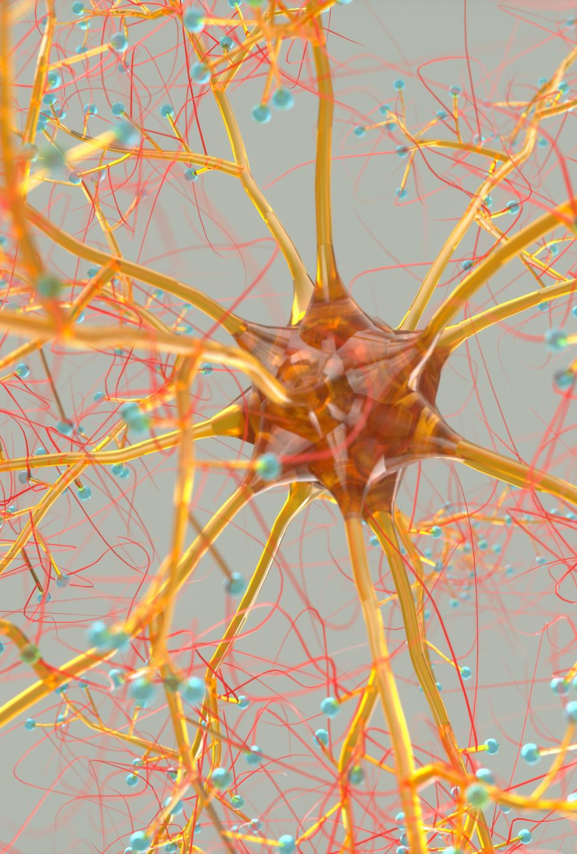
Duane Syndrome
There is failure of innervation of the lateral rectus by a hypoplastic sixth nerve nucleus, with anomalous innervation of the lateral rectus by fibers from the third nerve. It is often bilateral.
It is characterized by retraction of the globe on attempted abduction due to co-contraction of the medial and lateral recti.
Up to half of the patients have systemic defects such as deafness, speech disorder and skeletal abnormalities.
The condition has different types according to severity and variability. Some cases have straight eyes in primary position, others have face turn to compensate.
Most cases do not need surgical intervention as CHP can restore BSV.

Slide 55
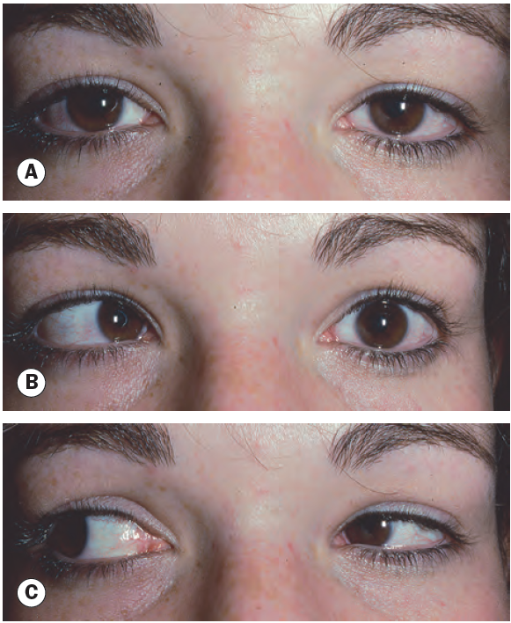

Slide 56

Brown Syndrome
Brown syndrome is a condition involving mechanical restriction of the superior oblique tendon passage through the trochlea.
It can be congenital or acquired such as trauma, inflammation (pansinusitis, scleritis, rheumatoid arthritis).
It is characterized by limited elevation in adduction without limitation in abduction. The eyes may be straight in primary position or there may by hypotropia with down-shoot in adduction depending on its severity.
Most congenital cases do not require treatment and may spontaneously improve towards the end of the first decade.
Acquired cases are treated according to the underlying cause (e.g., local injection of steroids).

Slide 57
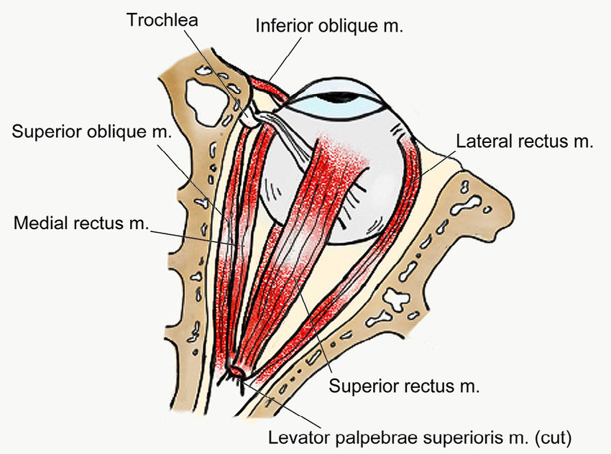

Slide 58
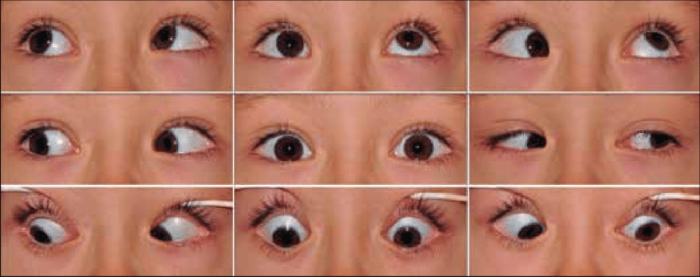

Slide 59
Surgery for squint

Slide 60
Surgery for squint
AIM:
  to correct misalignment to improve appearance &, if possible, restore BSV.
  to reduce an abnormal head posture.
Before surgical realignment is undertaken any significant refractive error and/or underlying amblyopia must be corrected.
Types:
  Strengthening procedures.
  Weakening procedures.
  Vector adjustment.

Slide 61
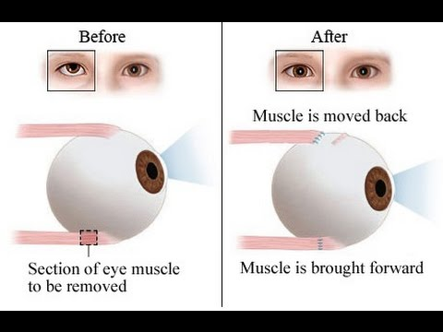
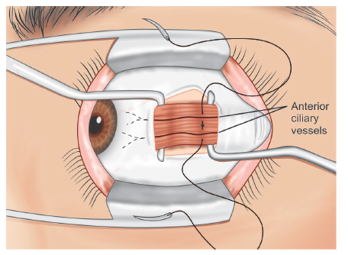
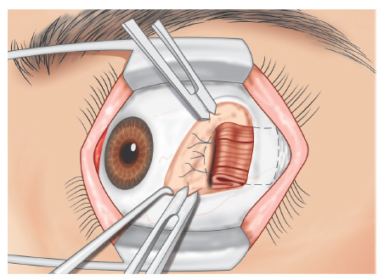
Strengthening procedures
Resection (suitable only for rectus muscles)
Plication
Advancement

Slide 62
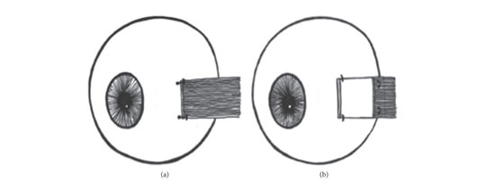
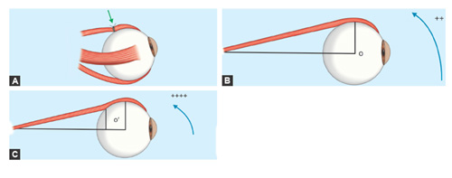
Weakening procedures
Recession: slackens a muscle by moving it away from its insertion. It can be performed on all muscles except sup oblique.
Disinsertion: it involves detaching the muscle from its insertion without reattaching it.
Posterior fixation sutures: anchoring its belly to the sclera to decrease its effective pull

Slide 63
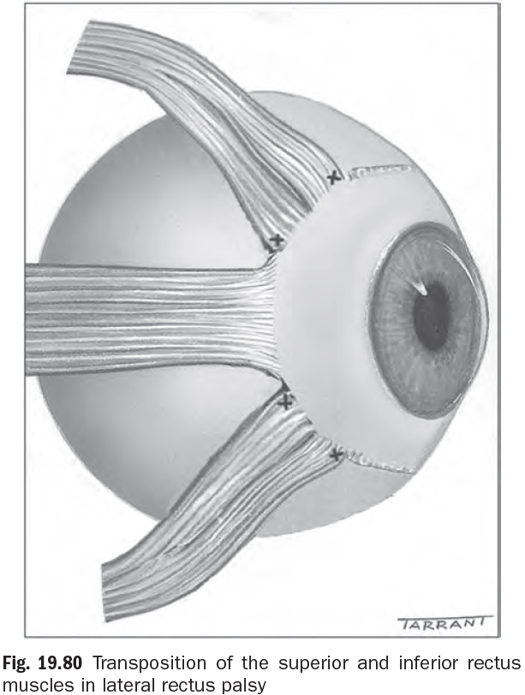
Transposition
Transposition refers to the relocation of one or more extraocular muscles to substitute for the action of an absent or severely deficient muscle.

Slide 64
Complications of strabismus surgery
Lost or ‘slipped’ muscle.
Globe perforation when suturing → endophthalmitis & retinal detach
Fibrosis and scarring.
Over and under-correction.
Postoperative diplopia.
Anterior segment ischemia.

Slide 65
THANK YOU

